Slide 1
ISIS Pulsed power for Injection and Extraction
Adrian McFarland
Electrical Engineering Group
Pulsed power section leader

Slide 2
Outline
Overview of ISIS
Injection Dipole – new design
Fast Extraction Kickers
ISIS Animation
Comments and Questions

Slide 3
ISIS
70 MeV H- single pass Linac
800 MeV Synchrotron
50Hz operation
Target station 1 average 150uA
Target station 2 average 40uA
1 in 5 Pulses to Ts2

Slide 4
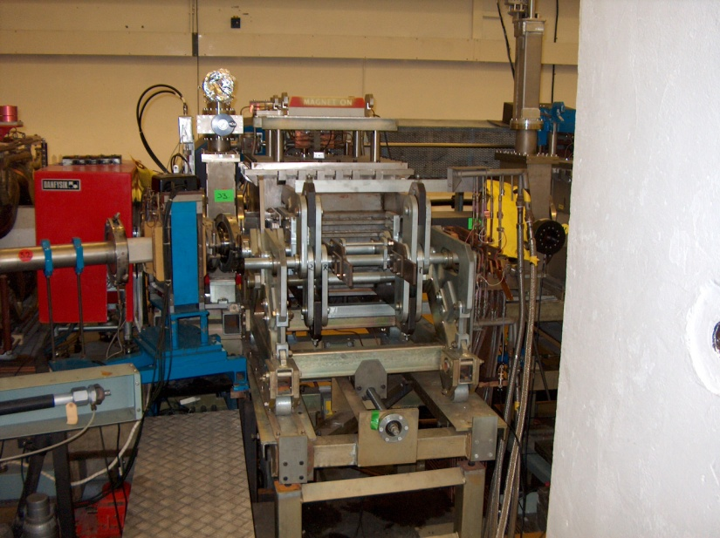

Slide 5
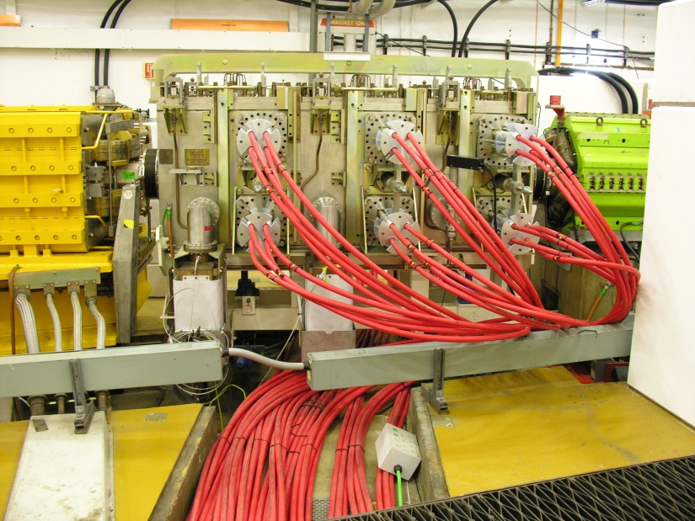

Slide 6
Injection Dipole

Slide 7
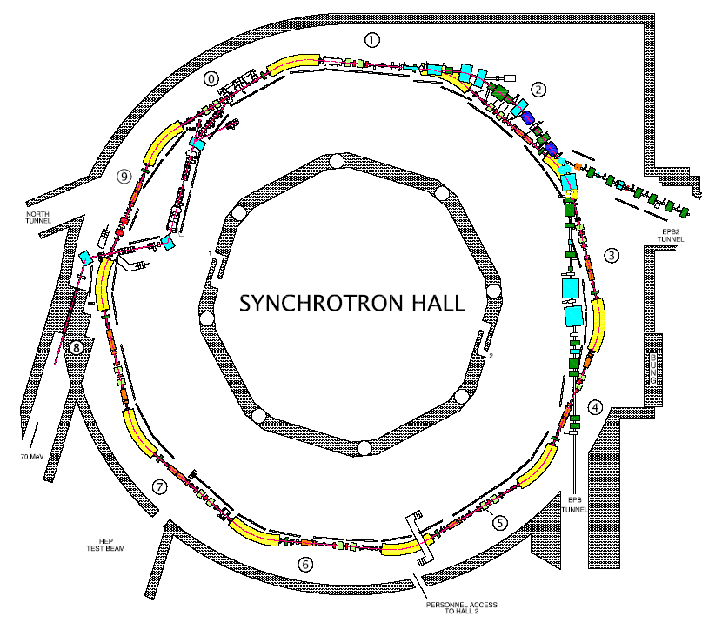
Injection Dipole
Injection into super period 0
12200A peek
Rise and fall times 80uS
400uS flat top
50 Hz operation
Dual charged power supply system

Slide 8
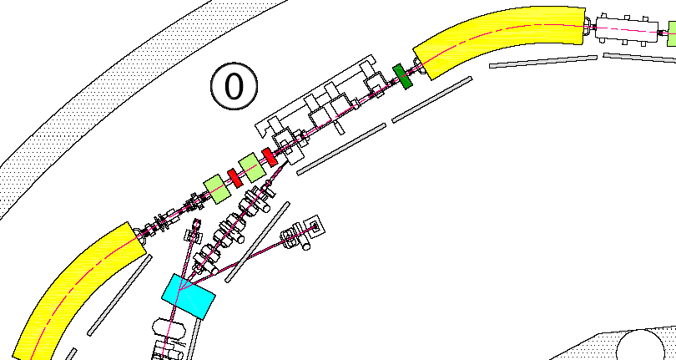
Injection Dipole
4 magnets run in series

Slide 9
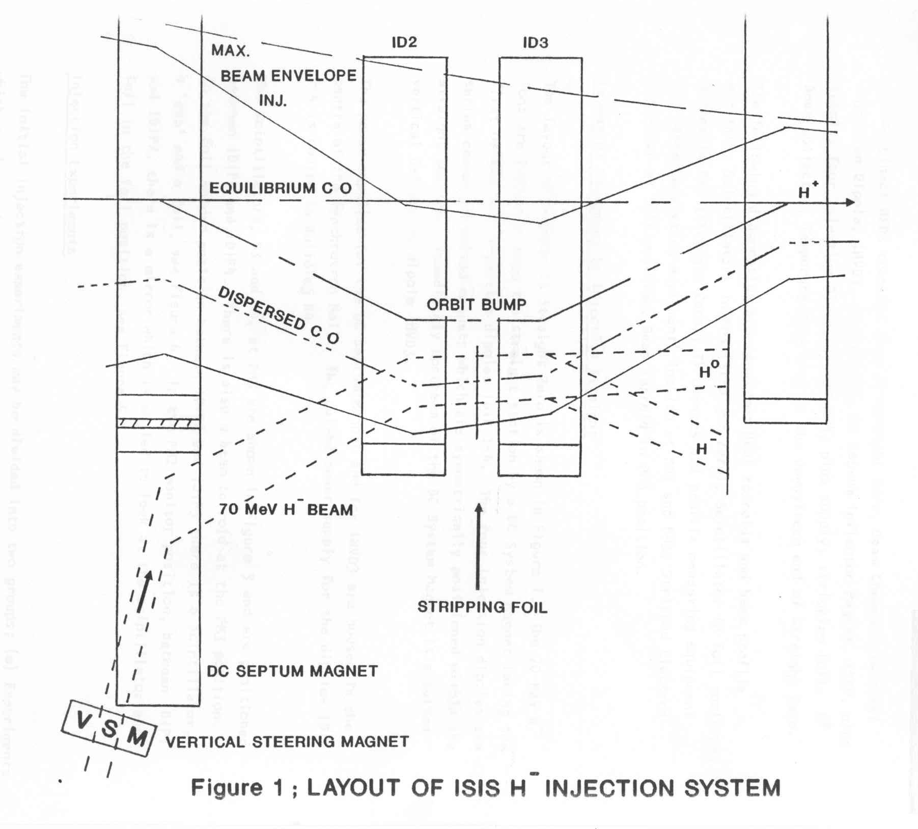
Injection in Super Period 0
H- Charge Exchange injection through an aluminium oxide stripping foil
Injection Dipole Magnets
Proton
H⁰
H⁻
Foil
Vertical Sweeper Magnet
70 MeV H⁻ Beam

Slide 10
Injection Dipoles
Single Turn / Ferrite Core
155 mm Aperture
Peak Field ~ 0.11 T
Peak Current ~ 12200 A
Rise / Fall Time ~ 80 µs
Flat-top ~ 400 µs

Slide 11
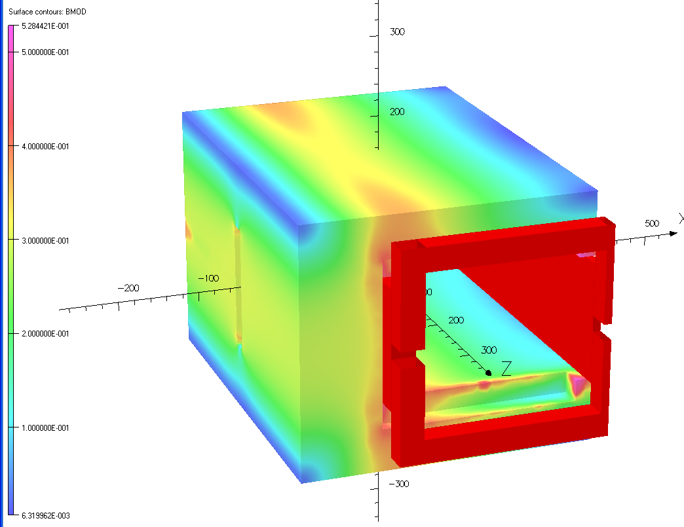
Magnetic Model
Current Values
Integral = 54.61 Tmm | Stored energy (Int (B.H/2) dv) = 85.6 J
Bmax = 0.0984 T | L (2.energy / I²) = 1.15 µH
L_{eff} = 555 mm | dt = 80 µs
I = 12195 Amps | V (L di/dt) = 175 Volts
Calculated current - 12195 A
Actual current – 12200 A
Calculated voltage - 175 V
Actual voltage ~ 250 – 300 V

Slide 12
180 MeV Injection
Dipoles
155 mm Aperture
Assuming the same geometry
Peak Field ~ 0.18 T
Rise / Fall Time ~ 80 µs
Flat-top ~ 400 µs

Slide 13
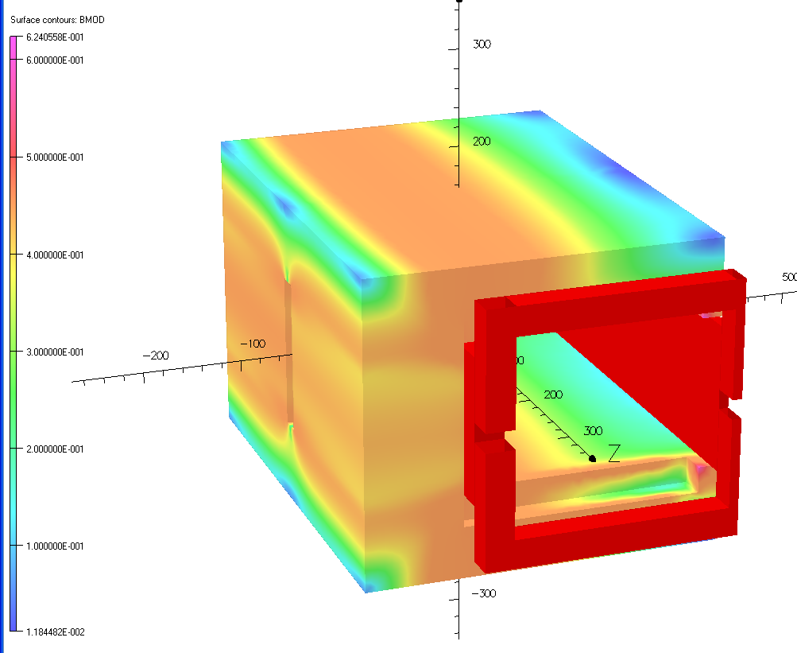
180 MeV Magnetic Model
Estimation on new values
Integral = 91.3 Tmm | Stored energy (Int (B.H/2) dv) = 243 J
Bmax = 0.165 T | L (2.energy / I²) = 1.13 µH
L_{eff} = 553 mm | dt = 80 µs
I = 20725 Amps | V (L di/dt) = 290 Volts
Calculated current - 20725 A
Calculated voltage - 290 V

Slide 14
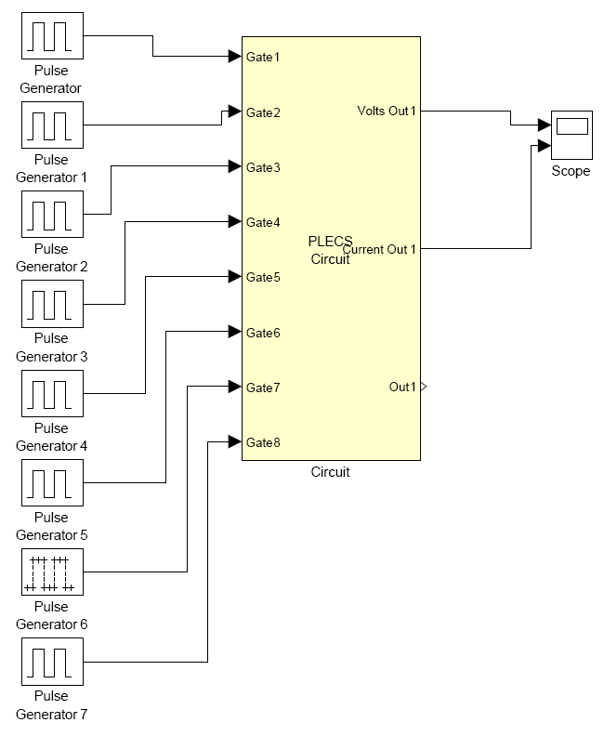
Power Supply
I > 21000 A
Rise / Fall ~ 80 µs
Flat-top ~ 400 µs
Possibility of Tuneable Gradient on “Flat-top”

Slide 15
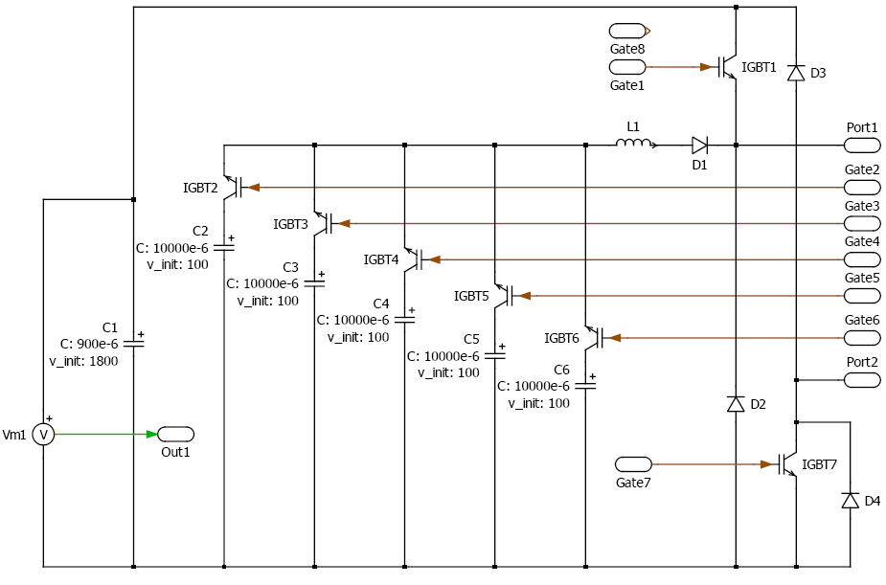
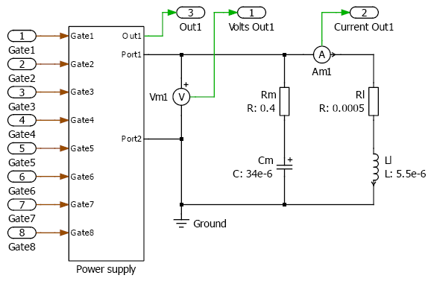
P/S Schematic

Slide 16
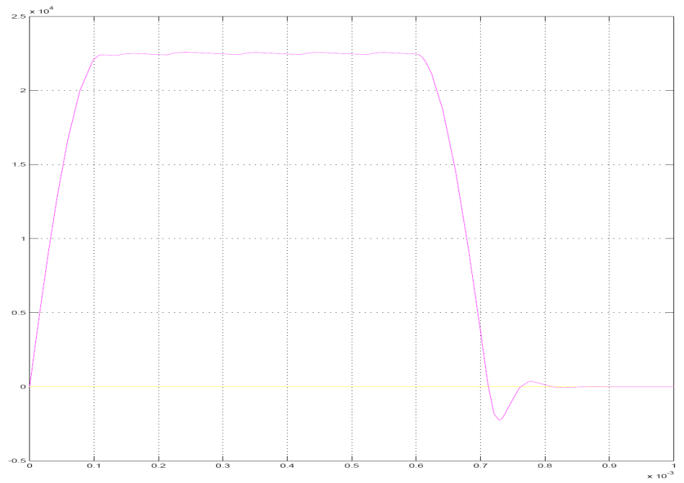
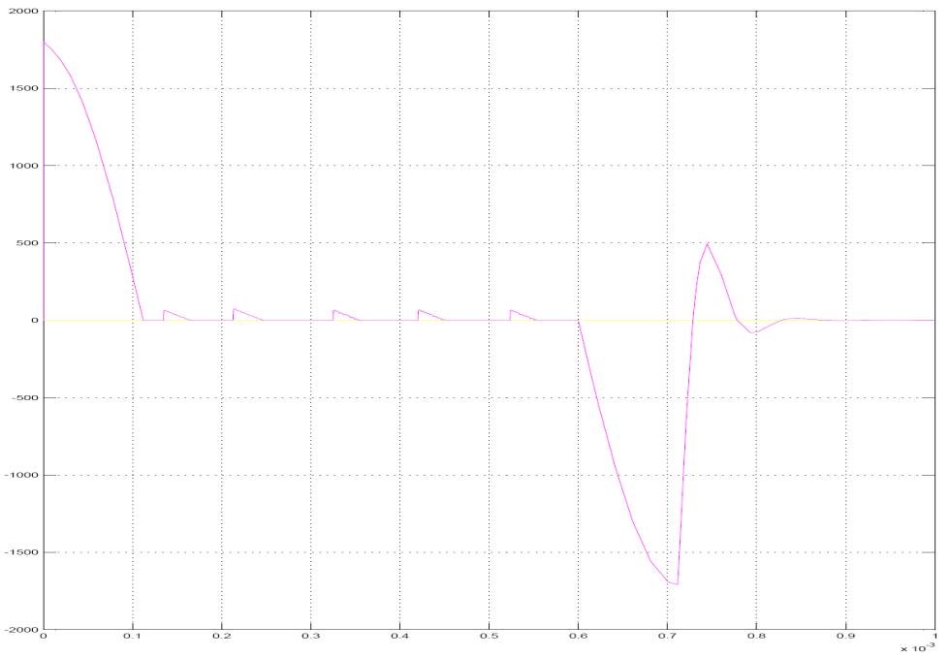
P/S Simulation
Current waveform
Voltage waveform

Slide 17
Fast Extraction Kickers

Slide 18
Fast Extraction Kickers
Parameters |  | Units
Number of Power Supply Systems | 6
Number of magnets | 3
PFN Voltage | 36 (60 max) | kV
Current | 5000 (8000 max) | A
Current Rise Time | 80 - 120 | nS
Field Rise Time | <210 | nS
Gap | 181 | mm
Pole Width | 147 | mm
Magnet length | 0.7 | m
Bending angle | 5.23 | mrad
Cable impedance | 6.25 | ohms
PFN Impedance | 3.75´2 | ohms
Magnet Inductance | 0.39+0.39 | mH
Magnetic field | 365 | G
Magnet type | L, 2C, short

Slide 19
Fast Extraction Kickers
Extraction from super period 1
5000A peek
Rise time 80 - 120nS
50 Hz operation
6 power supply operation

Slide 20
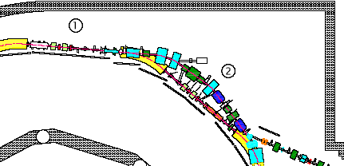
Fast Extraction Kickers
3 Kicker magnet3 in Super period 1

Slide 21
Fast Extraction Kickers
Beam Pulse structure in Synchrotron at 800 MeV
100 ns beam , 200 ns Gap
Beam Pulses
Kicker Current
Kickers fire in 200 ns gap
~100 ns rise time to 5000 A
Deflecting beam ~ 1 degree

Slide 22
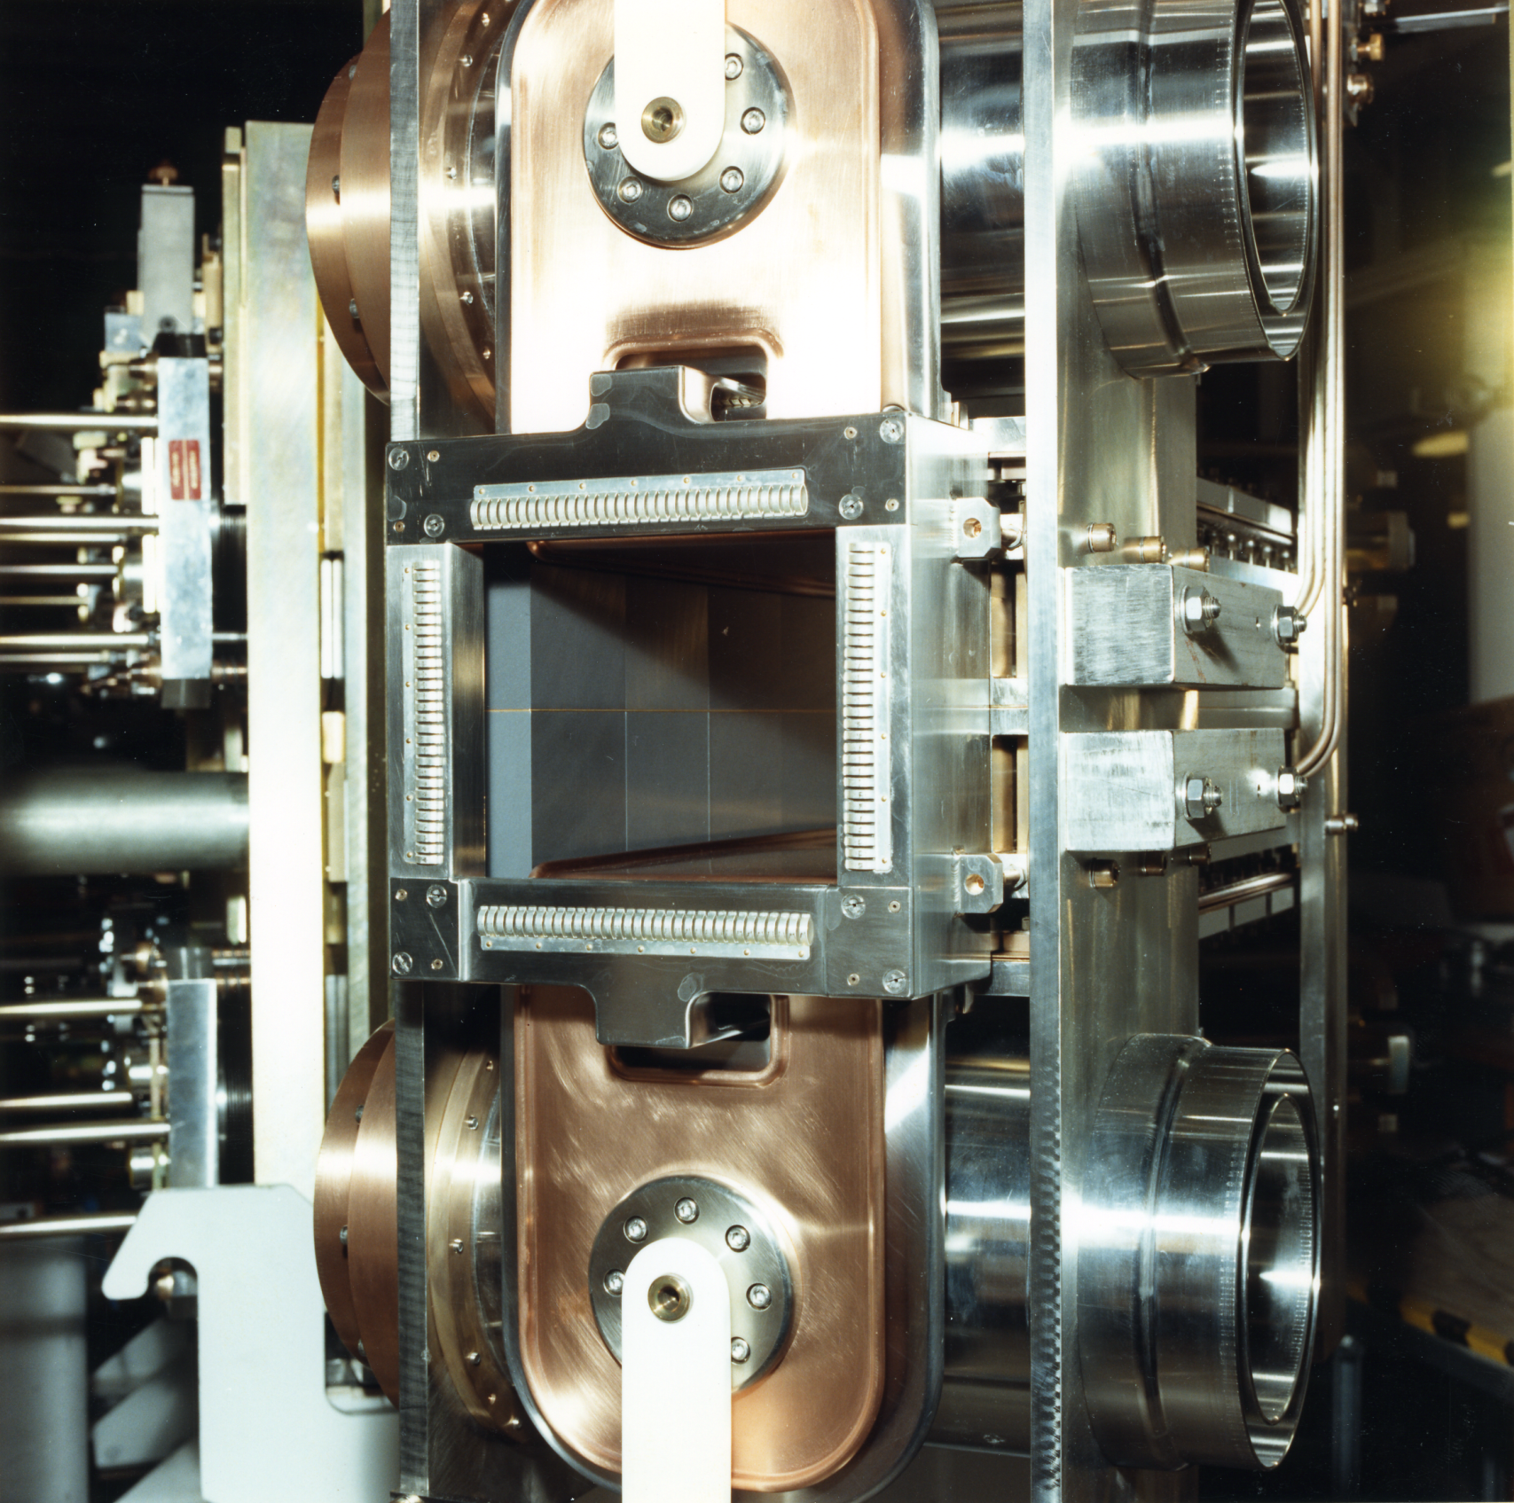
Fast Extraction Kickers

Slide 25
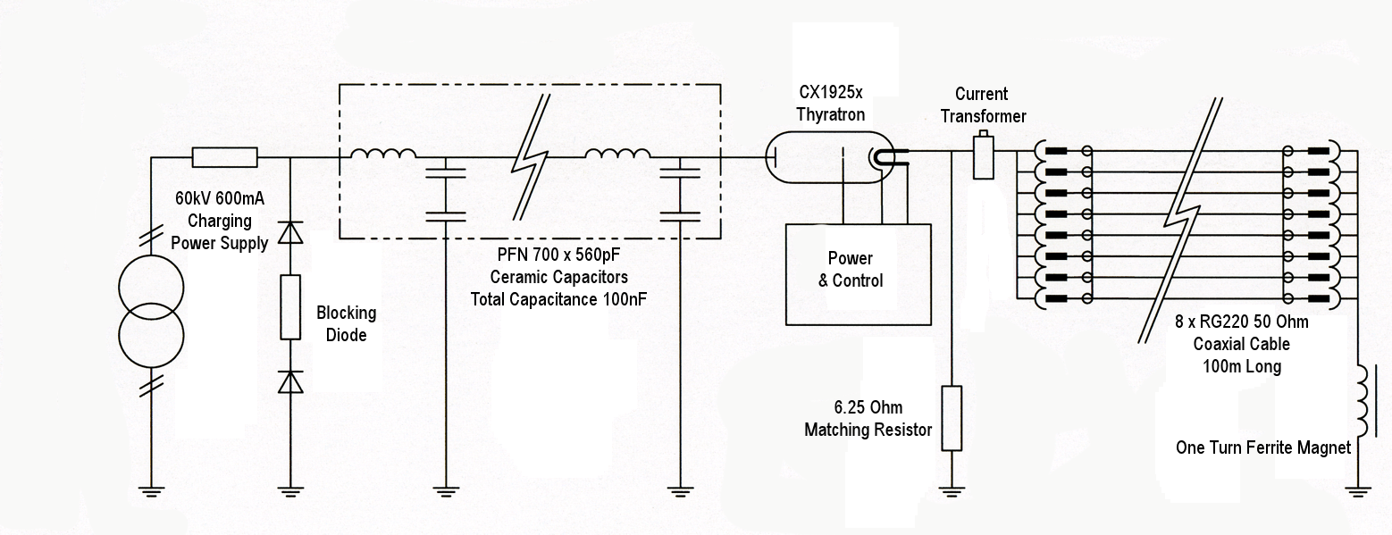
Fast Extraction Kickers
Power Supply System

Slide 26
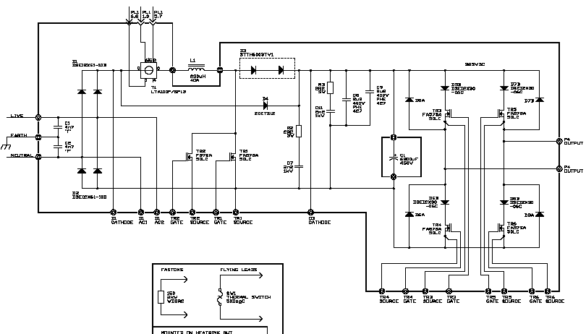
Fast Extraction Kickers
Power Supply System

Slide 27
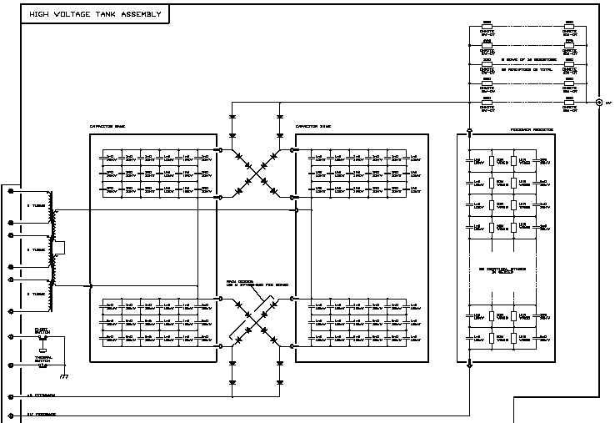
Fast Extraction Kickers
Power Supply System

Slide 28
Fast Extraction Kickers

Slide 29
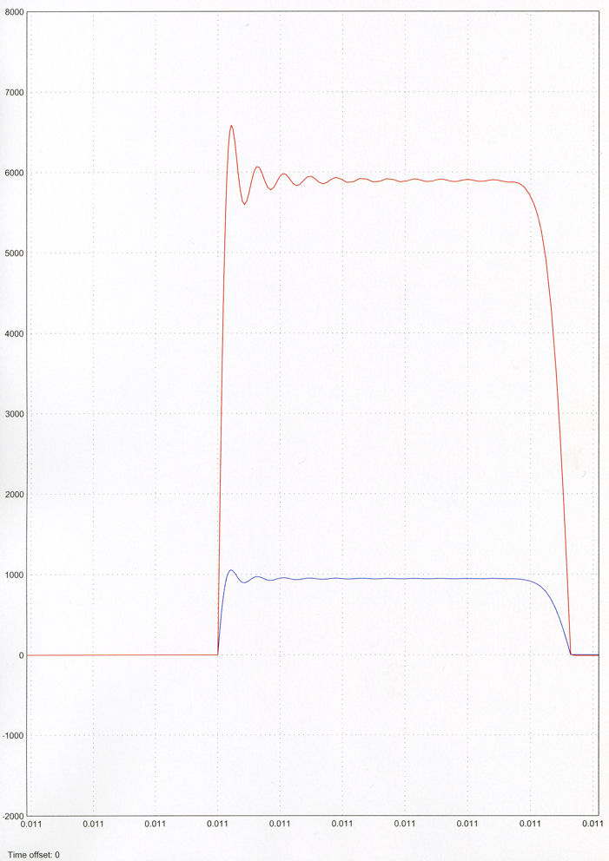
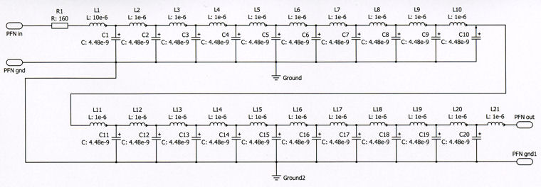
Fast Extraction Kickers
Power Supply System
Model Using PLECS through MATLAB

Slide 30
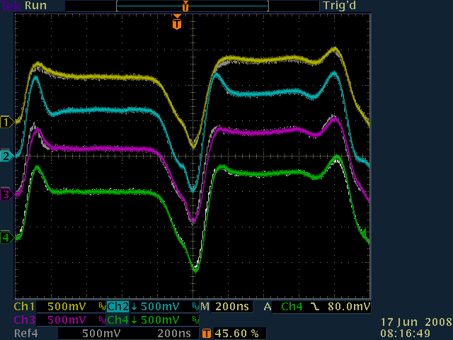
Fast Extraction Kickers
Power Supply System
View of kickers K1P to K2N
Reflected W ave used for diagnostics
All six systems aligned within 10nS

Slide 31
ISIS Animation

Slide 32
Thanks for listening
Any Questions?

